Slide 1
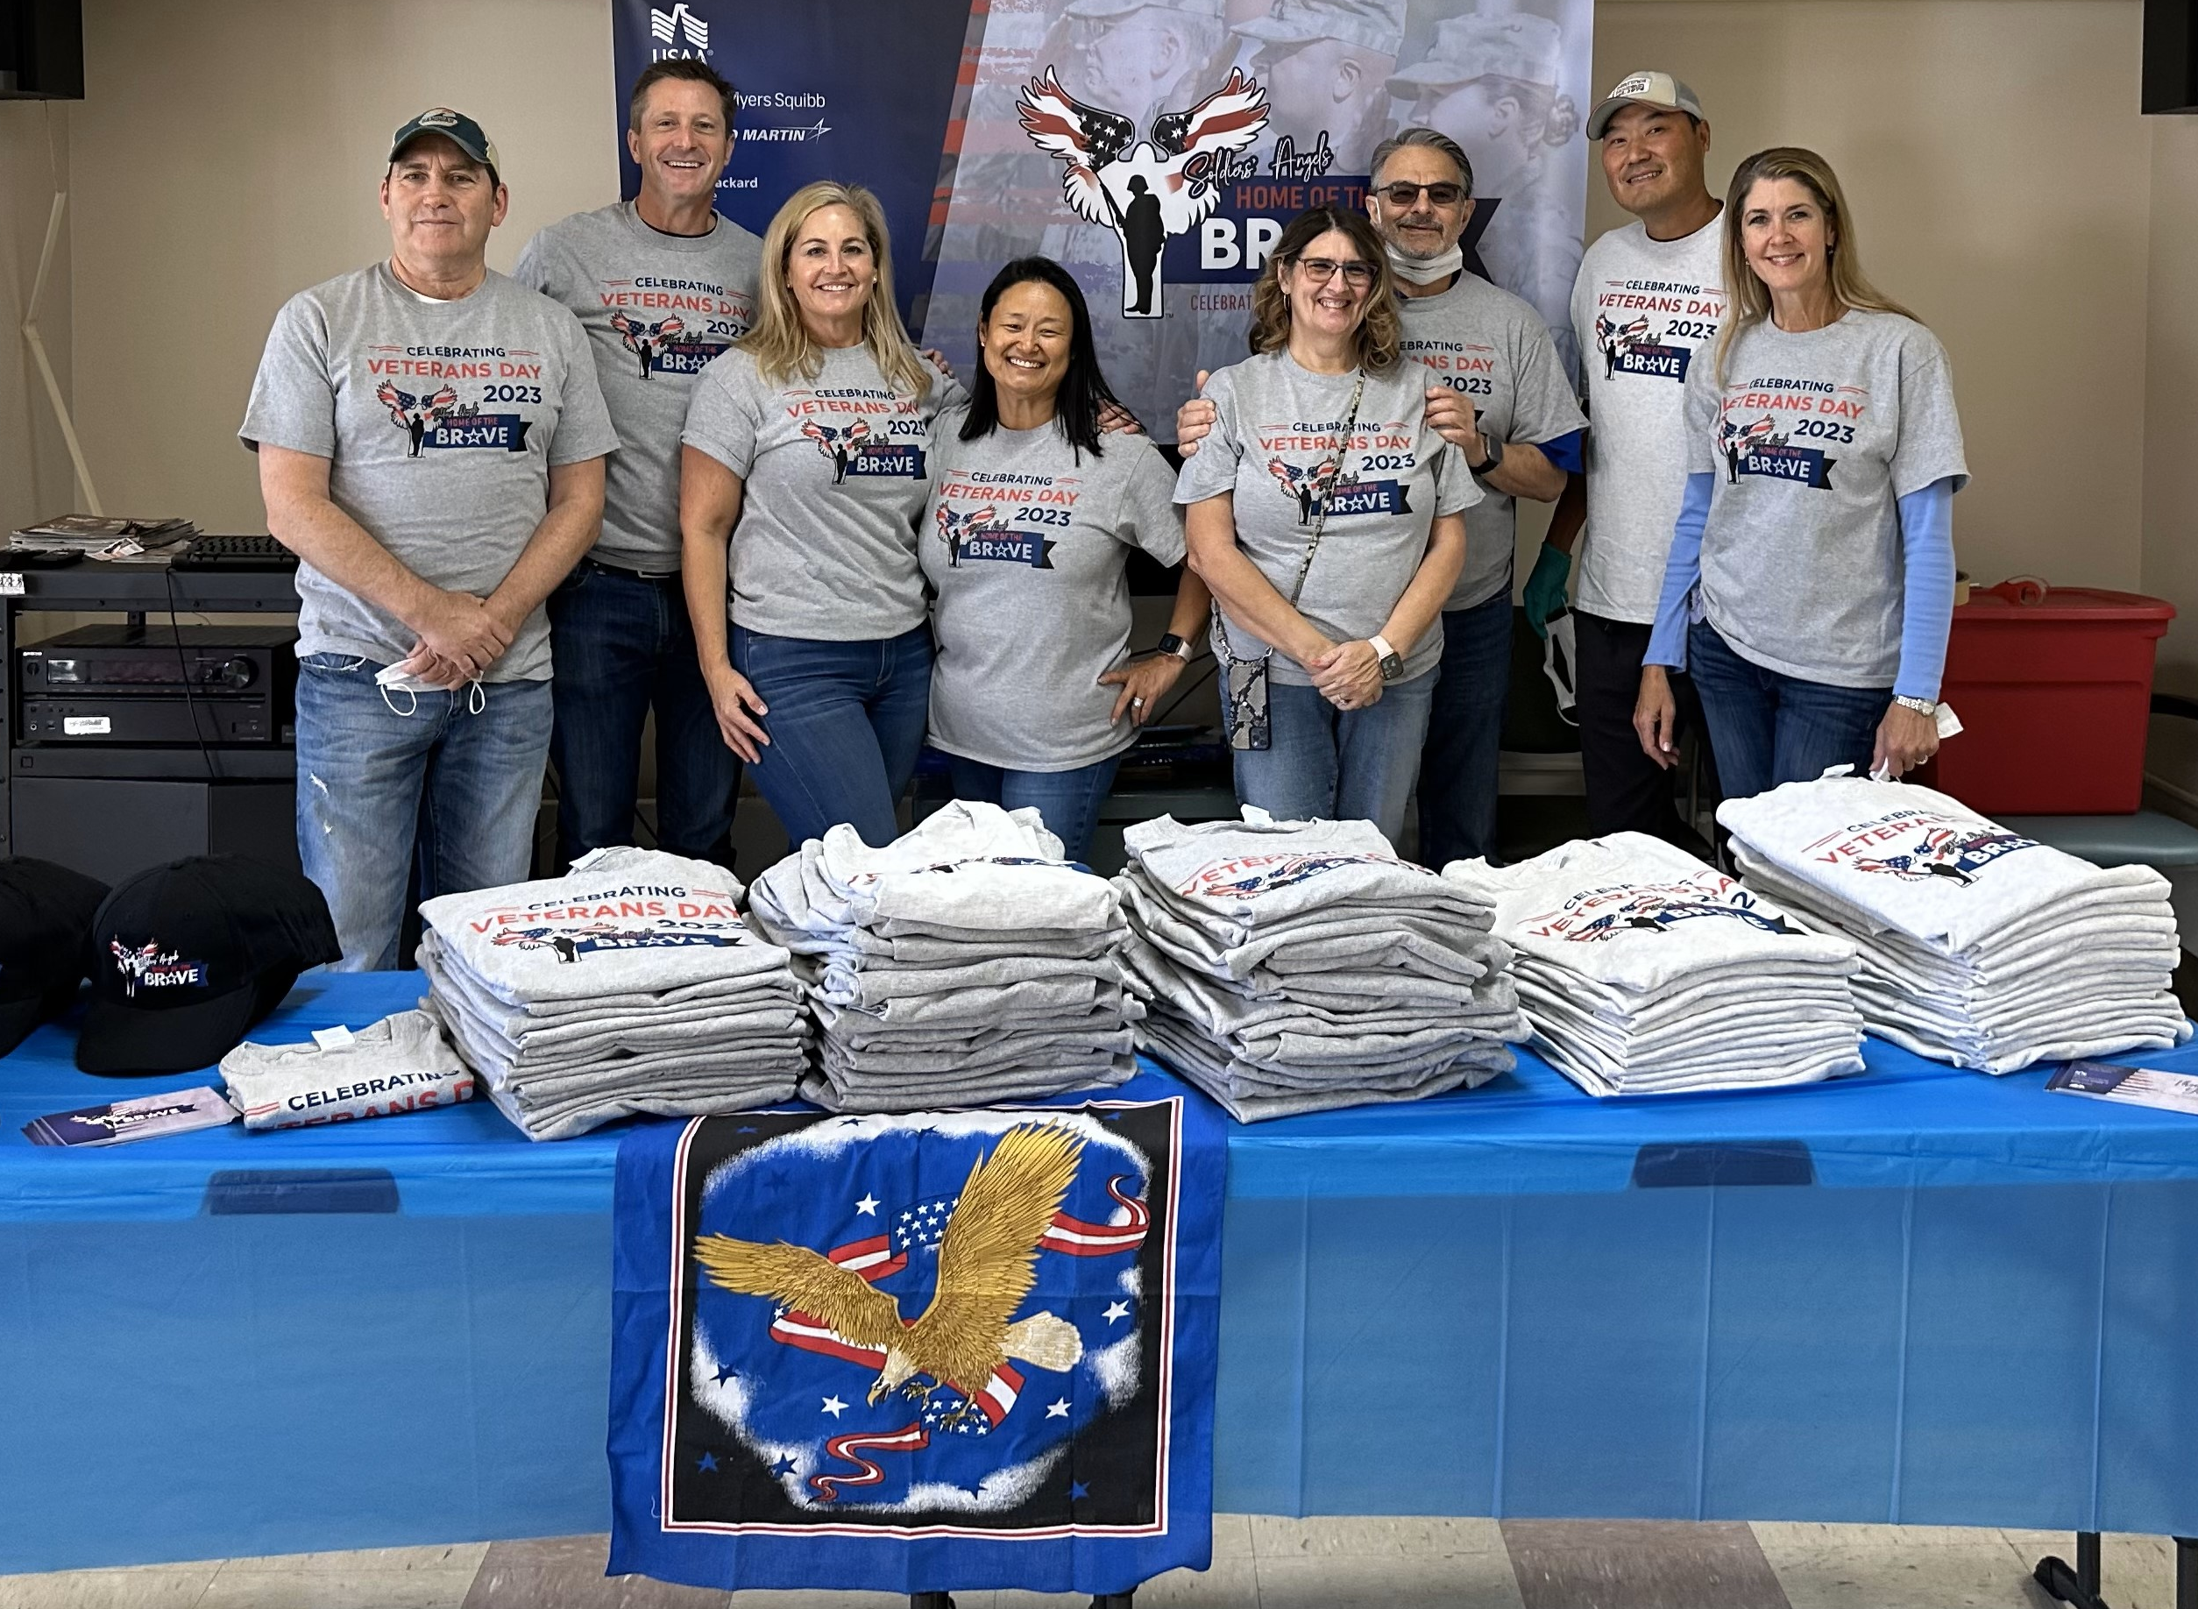
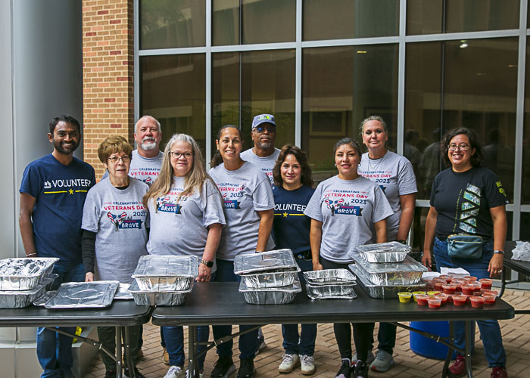
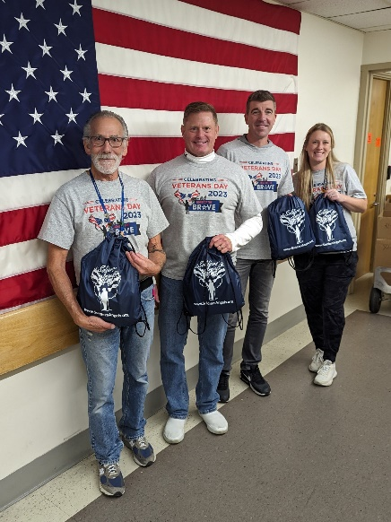
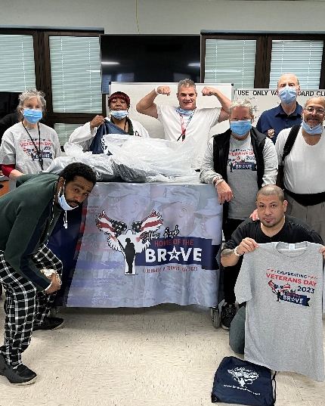
CDCE Chiefs & Staff Training

Slide 2
What is
Home of the Brave?
Our mission: To honor and show gratitude to every generation of Veteran for the sacrifices made in service to our country
Soldiers’ Angels Home of the Brave is a campaign that started in 2012 working directly with the VA Center for Development and Civic Engagement (CDCE), and corporate partners to honor Veterans on Veterans Day.
Partners fund the campaign and provide volunteer opportunities for employees in the local communities where they live and work, giving companies and employees the opportunity to show their gratitude.

Slide 3
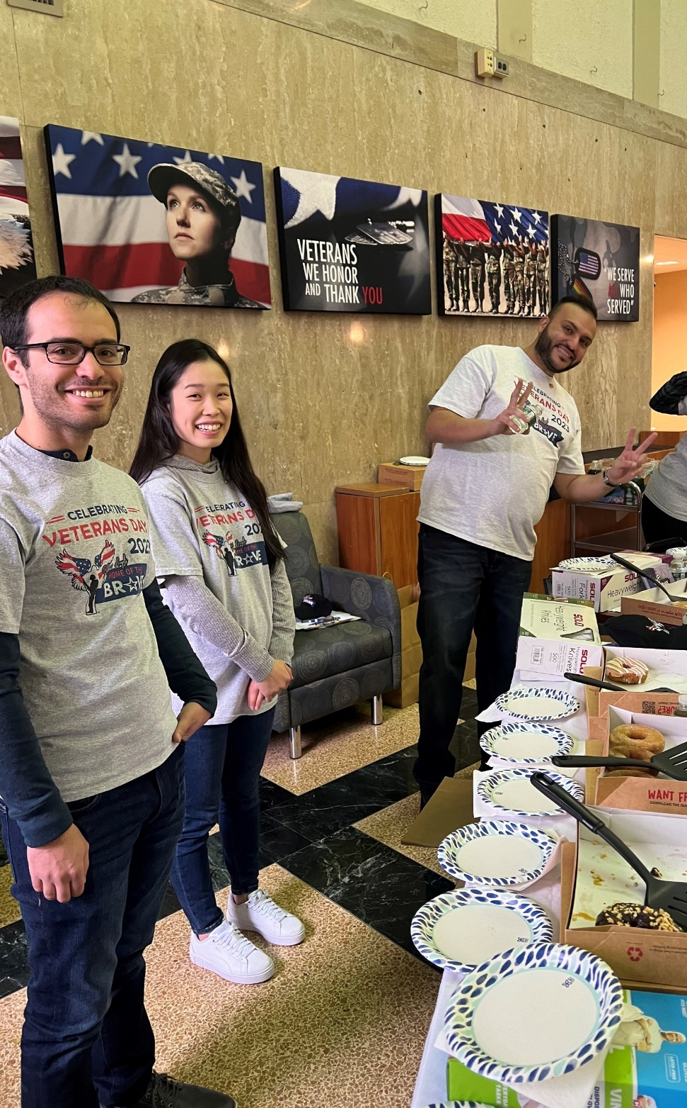
How it works:
Corporate partners join the campaign
CDCE Chiefs register medical facilities
Site Coordinators connect
Volunteers register

Slide 4
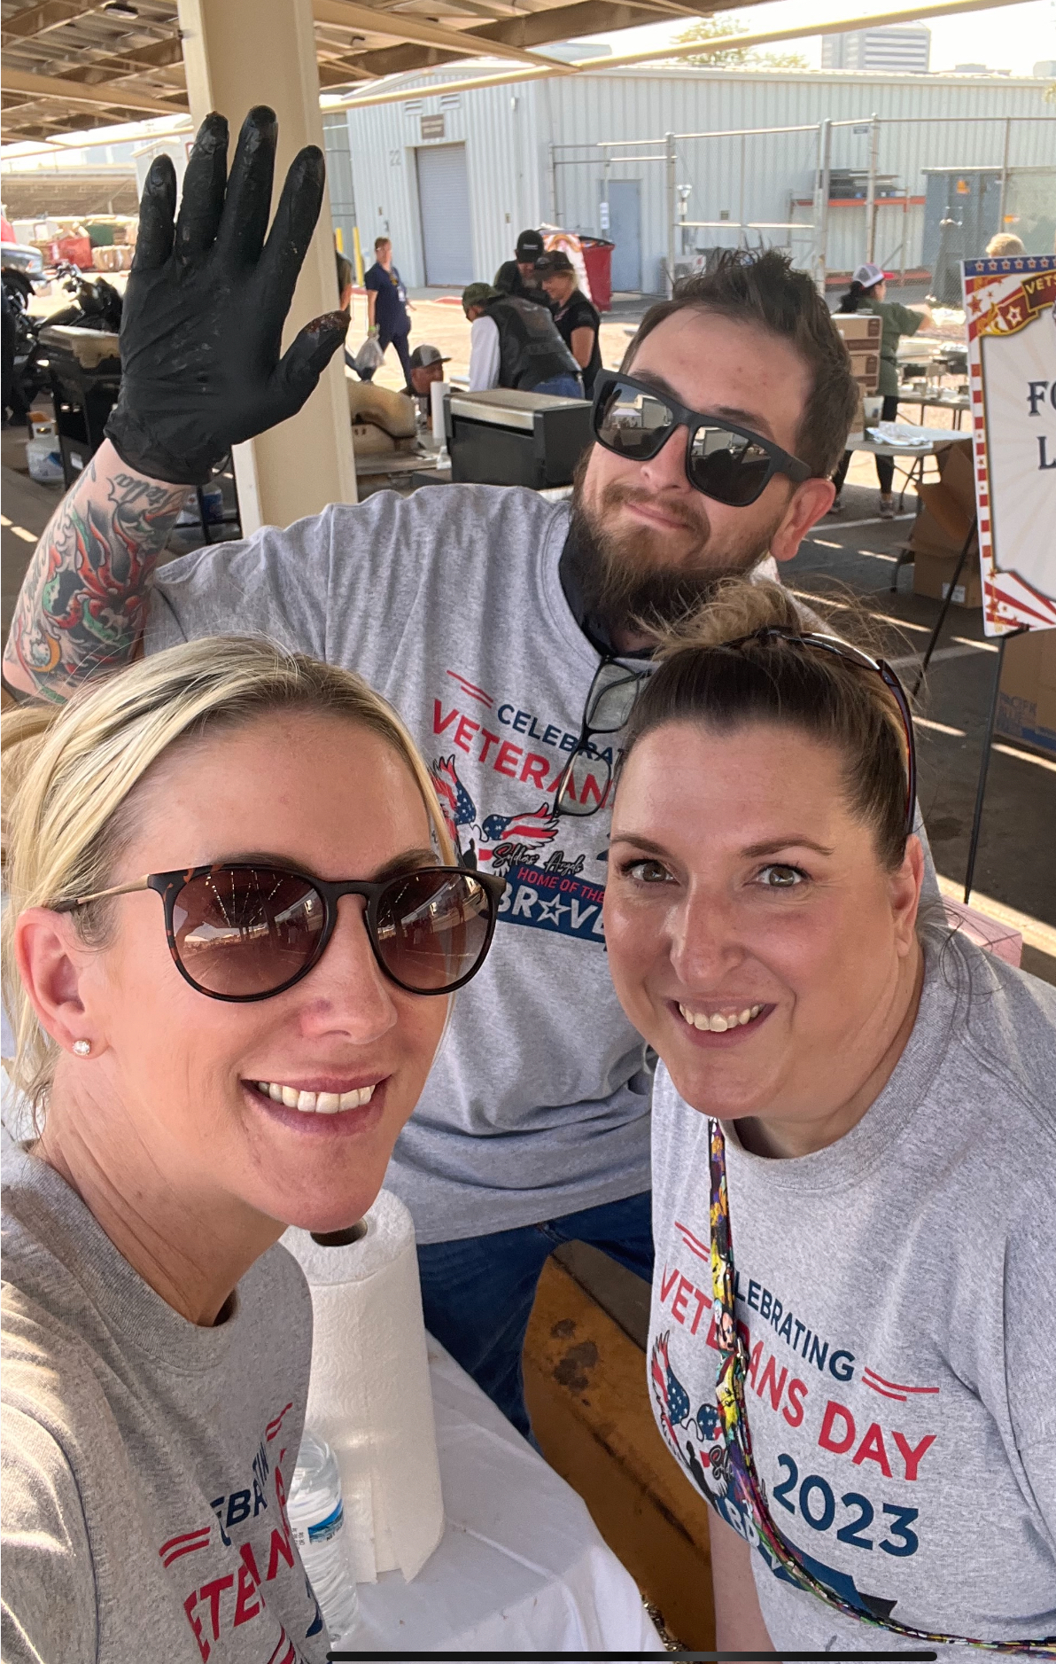
VA Site Registration
July 1– September 1:
Registration will be open for VA sites to register
Provide your contact information as chief
Back-up contact
Number of in-patient beds
Shirt/cap order
Special notes or regulations for volunteers
To participate, you must be available to collaborate with the Site Coordinators to finalize event details in a timely manner.
Celebrations and/or patient visits will take place between the 10th and 14th of November

Slide 5
Site coordinators (SC)
Site Coordinators (SCs) are super volunteers from sponsoring companies who work with you to prepare for a Veterans Day event or patient visit.
Site Coordinators are recruited for sites that are registered. The sooner your site is registered, the better chance we will have of providing an SC.
SC’s also:
Pack cinch bags
Make/collect items to donate for hygiene kits *please note SC's will only order the number of hygiene kits that will be used for patient visits.
Manage a site budget to help with the celebration costs
Manage volunteers
Site Coordinators are your local source for Home of the Brave information along with your Soldiers’ Angels Rep. if one is assigned.

Slide 6
Volunteers
Volunteers come from sponsoring companies and if needed, Soldiers’ Angels, friends and family in the local area
Registration for volunteers will begin in September when Veterans Day celebrations have been confirmed
Volunteer hours and the value of donations are reported back to each VA facility to be recorded under Soldiers’ Angels. SC’s do not have this information. It will come from Soldiers’ Angels by the end of November/first of December.

Slide 7
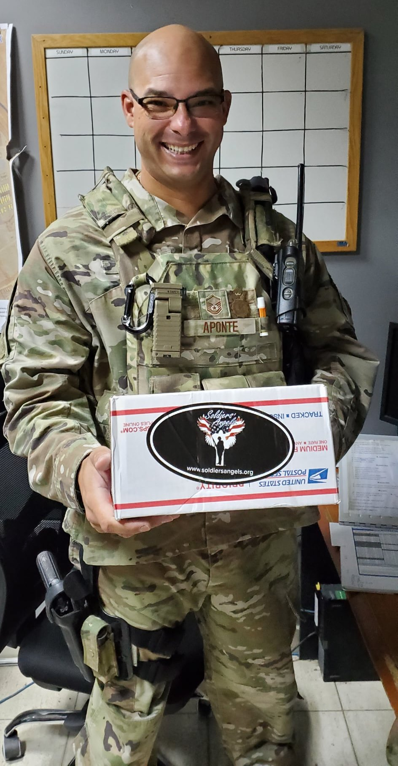
Timeline
CDCE Chiefs register medical facilities (July 1, 2025-September 1, 2025)
Order t-shirts and/or caps based on bed count by September 1, 2025
Work with a site coordinator to plan an event or activity (Deadline September 27)
Banners & cinch bag orders due September 27 (Ordered only by SC)
All orders delivered to your VA by October 25
** Orders will be delivered to the CDCE office, and the Site Coordinator will be responsible for getting the shirts prior to the event.

Slide 8
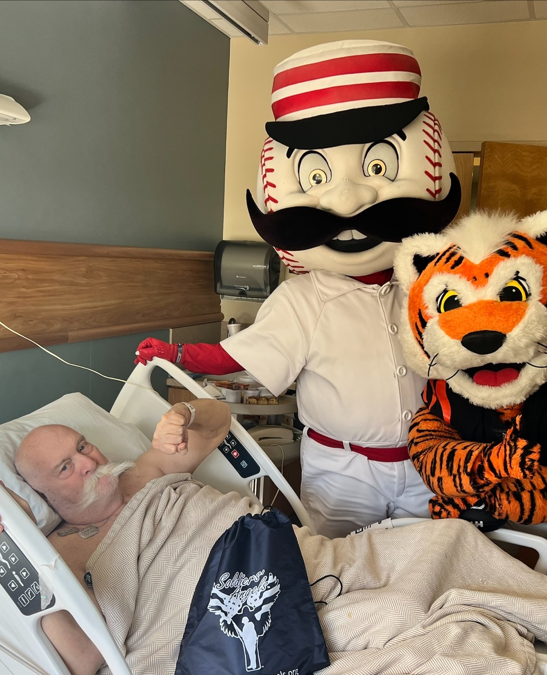
VA CDCE Benefits
Veterans at your facility are honored on Veterans Day, at a minimum, with a shirt or cap and thank you card
Partner volunteers living in the area are introduced to the VA and CDCE
Many site coordinators become Soldiers’ Angels reps for sites not already covered which results in year-round support

Slide 9
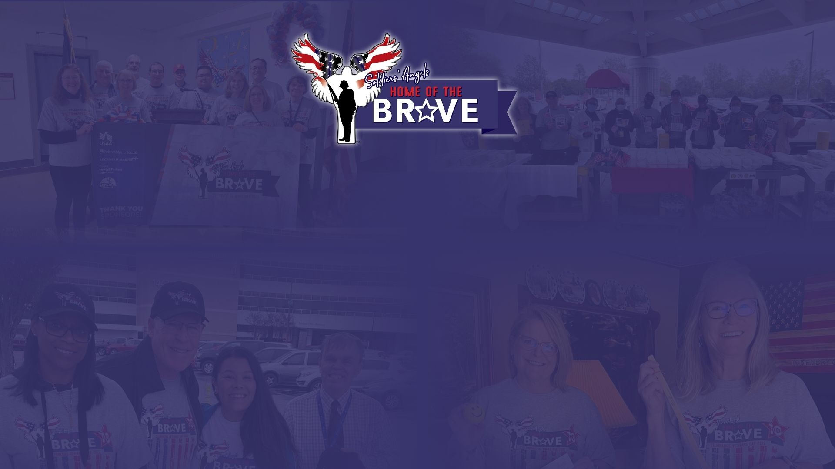
Thank You!

